Slide 1
Compiler Design
Prepared by
Ch. Chakradhara Rao

Slide 2
Syllabus
UNIT-1
Language Processors: Introduction, the structure of a compiler, the science of building a compiler,
programming language basics.
Lexical Analysis: The role of the lexical analyzer, input buffering, recognition of Tokens, the
lexical analyzer generator lex program specification, finite automata, from regular expressions to
automata, design of a lexical-analyzer generator, optimization of DFA-based pattern matchers.
UNIT-2
Syntax Analysis: Introduction, context-free grammars (CFG), derivation, top-down parsing,
recursive and non recursive top down parsers, bottom-up parsing, Operator precedence parser,
Introduction to LR parsing: simple LR parser, more powerful LR parsers, using ambiguous
grammars, parser hierarchy, and automatic parser generator YACC tool.

Slide 3
Syllabus
UNIT-3
Syntax-Directed Definitions: Introduction, evaluation orders for SDD’s, applications of
syntax-directed translation, syntax-directed translation schemes, and implementing L-
attributed SDD’s.
Intermediate-Code Generation: variants of syntax trees, three-address code, types and
declarations, type checking, control flow statements, switch-statement, and procedures.
UNIT-4
Run-Time Environments: Storage organization, stack allocation of space, access to nonlocal
data on the stack, heap management, introduction to garbage collection, introduction to trace
based collection.
Machine Independent Code optimizations: The principal sources of optimization,
introduction to data-flow analysis, foundations of data-flow analysis, constant propagation,
partial redundancy elimination, and loop optimization in flow graphs.

Slide 4
Syllabus
UNIT-5
Code Generation: Issues in the design of a code generator, the target language, addresses
in the target code, basic blocks and flow graphs, optimization of basic blocks, a simple
code generator.
Machine Dependent Code Optimizations: peephole optimization, register allocation and
assignment, code generation algorithm.

Slide 5
Unit – 1
1. Introduction to Language Processors 2. The structure of a compiler
3. The science of building a compiler 4. Programming language basics
5. The role of the lexical analyzer 6. Input Buffering
7. Recognition of Tokens 8. The lexical analyzer generator lex program specification
9. Finite automata 10. Regular expressions to automata
11. Design of a lexical-analyzer generator 12. Optimization of DFA-based pattern matchers

Slide 6
Basic Terminology:
Computation:
Computation can be defined as finding solution to a problem from given inputs by means of algorithm
Symbol:
A symbol is a single object / character
Normally, characters from a typical keyboard are used as symbols
Example: A, a, α(alpha), λ(Lambda), etc…
Alphabet:
An alphabet is a finite, non-empty set of symbols / characters and is denoted by ∑
Example: ∑= {0, 1} is the binary alphabet, consisting of the symbols 0 and 1
∑ = {a, b, c} is an alphabet of three symbols
∑ = {A, B,………, Z} is the uppercase English alphabet
Power of an alphabet is the set of all strings of length k over alphabet i.e., s^{k}
Example: S={0,1}→ s¹ ={0,1}, s² ={00,01,10,11}, s³ ={000,…111}, etc…

Slide 7
Basic Terminology (Cont…):
String: It is a finite sequence of symbols chosen from ∑ and is denoted by W or S
Example: If ∑ = {0, 1} then 111, 11, 11, 10, 01… are some of the strings chosen from this ∑
If ∑ = {a, b} then aa, bb, ab, ba, abab, aabb… are the words chosen from this ∑
Length of a string w is the no. of symbols composing the string and is denoted by |w|
Example: If w = aabb then |w| = 4
If w = 010110 then |w| = 6
Empty string is the string with zero symbols and zero length & is denoted by ϵ & |ϵ|=0
A prefix of a string is any no. of leading symbols of that string
A suffix of a string is any no. of trailing symbols of that string
Example: string abc → prefix: ϵ, a, ab, abc and suffix: ϵ, c, bc, abc
A prefix / suffix of a string other than the string itself is called a proper prefix / suffix
Concatenation of 2 strings is writing the 1st string followed by 2nd string with no space
Example: Let x=ab, y=pq then xy=abpq and yx=pqab
The empty string ϵ is the identity for the concatenation operator i.e., ϵw = wϵ = w
Kleene star: It is the set of all strings over ∑ is conventionally denoted by ∑*
Example: If ∑ {0,1} then ∑* = {ϵ,0,1,00,01,10,11,000,…..111,….} = ∑⁰ U ∑¹ U ∑² U ∑³
Positive closure: It is the set of all non-empty strings over ∑ is denoted by ∑⁺
Example: If ∑ {0,1} then ∑⁺ = {0,1,00,01,10,11,000,…..111,….} = ∑* -{ϵ}

Slide 8
Formal Language:
Automaton:
An automaton (plural: automata) is a self-operating machine. The term "Automata" is derived from the Greek word "αὐτόματα“.
Language:
A language L is a set of strings over the given alphabet and it can be finite or infinite
Example: If ∑ = {a, b} then
1. L1 = { set of all strings of length 2} = {aa, ab, ba, bb} --- Finite
2. L2 = { set of all strings which starts with a} ={a, aa, ab, aaa, aba, abb, ……} --- Infinite
3. Language containing the null string is { ϵ}
4. Null language: { } = ф
Operations on Language:
Union (or) 6. Complementation (not)
Intersection (and) 7. Symmetric difference (xor)
Concatenation (join) 8. Length sub-setting of a language
Reversal 9. Kleene star / Positive closure
Palindrome 10. De Morgan’s Laws

Slide 9
Operations on Language:
1. Union:
If L₁ & L₂ are two languages then the L₁ U L₂ containing all strings from both languages
Example: Let L₁ = {0,01,10,11}, L₂ = {0,01,001} → L₁ U L₂ = {0,01, 001,10,11}
Let L₁ = {0,00,000,….}, L₂ = {0,000,0000,…} → L₁ U L₂ = {0}⁺
2. Intersection:
If L₁ & L₂ are two languages then the L₁ ∩ L₂ containing common strings from both languages
Example: Let L₁ = {0,01,10,11}, L₂ = {0,01,001} → L₁ ∩ L₂ = {0,01}
Let L₁ = {0,00,000,….}, L₂ = {0,000,0000,…} → L₁ ∩ L₂ = {0,000}
3. Concatenation:
If L₁ & L₂ are two languages then the L₁L₂ containing all strings
Example: Let ∑ ={0,1} and L₁, L₂ are two languages over S
L₁ = {00,11}, L₂ = {0,1} → L₁L₂ ={000,001,110,111}
→ L₂L₁ ={000,011,100,111}

Slide 10
Operations on Language (Cont…):
4. Reversal:
This operation is similar to the reversal of a string operation. It can be written as L^{R} = {W^{R} |WϵL}
Example: If L={ab,bc,cd} then, L^{R} = {ba, cb, dc}
5. Palindrome:
A language called Palindrome over ∑= {a, b} is defined as:
Palindrome= {ϵ, all strings W, such that W^{R} =W and Wϵ∑} ≡ {ϵ,a,b,aa,bb,aaa,bbb,aba,abba,aaaa,…}
6. Complementation:
Let L is a language over an alphabet, then the compliment of L is denoted by L¹
It consisting of all those strings that are not in L over the alphabet
Mathematically, it is expressed as x ϵ L¹ if and only if xϵ∑* - L
Example: If ∑ ={a,b} and L={a,b,aa} then the complement of L is {ϵ, ab,ba,bb, ……}
i.e., L¹ = ∑*-L = {ϵ,a,b,aa,bb,ab,ba,aaa,bbb,……}-{a,b,aa} = {ϵ,bb,ab,ba,……}

Slide 11
Operations on Language (Cont…):
7. Symmetric difference:
Let L₁ and L₂ are two languages over an alphabet ∑ and is denoted by L₁ ⊕ L₂
It can be defined as L₁ ⊕ L₂=(L₁ U L₂)-(L₁ ∩ L₂)
Elements of L₁ ⊕ L₂ are contained either in L₁ or L₂ but not in both
Example:
Let L be a language over an alphabet ∑ then clearly L ⊕ ф=L,
L ⊕ L= ф,
L ⊕ ∑* = L¹
L ⊕ L¹ = ∑ *
8. Length sub-setting of a language:
Let L is a language over an alphabet
Then for sake of convenience or compactness, it may be required to specify the strings in L, of length less than or equal to a specific value or a fixed size
Example:
Let L={1,11,111,1111,…} then L=4= {1111} and L<=4 = {1, 11, 111, 1111}

Slide 12
Operations on Language (Cont…):
9. Kleene Closure and Positive Closure:
Kleene star is the set of all strings of any length over ∑ and is denoted by ∑*
Example: If ∑ {0,1} then ∑* = {ϵ,0,1,00,01,10,11,000,…..111,….} = ∑0 U ∑1 U ∑2 U ∑3
Positive closure is the set of all non-empty strings over ∑ is denoted by ∑+
Example: If ∑ {0,1} then ∑⁺ = {0,1,00,01,10,11,000,…..111,….} = ∑* -{ϵ}
10. De Morgan’s Laws:
It allows one to express the intersection of two languages over ∑, in terms of the two operation like, union and complementation
These are the fundamental laws in set theory
Let L₁, L₂, L₃ be any three languages, then L₁-(L₂ ∩ L₃) = (L₁-L₂) U (L₁-L₃)
L₁ ∩ L₂ = (L₁^{c} U L₂^{c})^{c}

Slide 13
Finite Automata:
An automata is defined as a system or model where information is transformed and used for performing some functions without direct participation of man.
Below figure shows Finite Automata (FA) model
i/p tape (string to be processed)
o/p
Input:
It is divided into several cells and each cell stores a single character
At each discrete instance of time t₁, t₂,…, t_{n}, i/p values are i₁, i₂,….., i_{n}
Each of which can take a finite number of fixed values from i/p alphabet summation (∑) are applied to the i/p side of the model
o/p
0 | 1 | 1 | 1 | 0 | 1 | 1 | 0 | 1 | 0
…………….
q₀
q₁
q₂
q_{f}

Slide 14
Finite Automata (Cont…):
Output:
o₁, o₂,….., o_{n} are outputs of the model
Each of which can take finite number of fixed values, common o/p that is yes / no in other way accepted/not accepted
States:
At any instant of time the FA can be one of the states q₀, q₁, ……, q_{n}
State relation:
At any instant of time the next state of automata is determined by the present state, present i/p
Output relation:
Output is related to either state only or both i/p and state

Slide 15
Finite Automata (Cont…):
Applications:
Traffic lights
Video Games
Speech Recognition
Text Parsing
Natural Language Processing
Highly useful in designing Lexical analyzers, designing text editors, designing spell checkers, designing Sequential Circuit design (or) Hardware Design, String processing, designing BOT (Web Robot)
Types:
Deterministic Finite Automata (DFA / DFSM)
Non-Deterministic Finite Automata (NDFA / NFA / NDFSM)

Slide 16
Deterministic Finite Automata (DFA):
It consists of finite no. of states and set of transitions from one state to another state on i/p symbols choosing from an input alphabet
For each i/p symbol their exactly only one transition (only one path from current state to next state on same i/p symbol)
Analytically it can be defined as quin tuple or 5 tuples: Q, ∑, δ, q₀, F
Where Q is finite non-empty set of states
∑ is input alphabet summation
δ is transition function Q * ∑ → Q
q₀ is start / initial state (an arrow along with first state)
F is set of final states (double circles)
For each state in Q, there is a corresponding node in the transition diagram
For each state in ‘Q’ and each i/p symbol ‘a’ in ‘∑’ and if δ(Q,a)=P then there is an arc or edge from Q to P

Slide 17
Deterministic Finite Automata (DFA) Cont…:
Transition Diagram:
It is a directed graph associated with finite automata, the vertex of the graph corresponds to the state of the finite automata
If there is a transition from state P to state Q on i/p symbol i then there is an edge / arc labelled by i from P to Q
The finite automata accepts a string “X”, if the sequence of transitions corresponding to the symbols of “X” leads from the starting to the final state
Transition Table:
It is a conventional tabular representation of a transition function “δ” that takes two arguments i.e., state and i/p symbol and returns a value i.e., state
0 1 →
q₀
q₁
q_{f}
δ | 0 | 1
q₀ | q₁ | --
q₁ | -- | q_{f}
q_{f} | -- | --

Slide 18
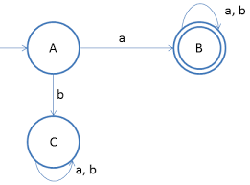
Deterministic Finite Automata (DFA) Cont…:
Dead / Dead End State :
A rejecting state that is essentially a dead end
Once the machine enters a dead state, there is no way for it to reach an accepting state, so we already know that the string is going to be rejected
Graphically, the dead state is often omitted and assumed for any input that the machine does not have explicit instructions on what to do with
A machine may have multiple dead states, but at most only one dead state is needed per machine
Ex: R = a(a+b)*
Here A is star state, B is final state and C is dead state

Slide 19
Problems on DFA:
Design a DFA which accepts the string 1010 only
Design a DFA which accepts the string 1010 or 1100
Design a DFA which accepts set of all binary strings
Design a DFA over ∑={0,1} in which the strings starting with 1 and such that the number of 0’s is divisible by 3
Design a DFA over ∑={0,1} which accepts set of all strings consists 3 consecutive 0’s
Design a DFA over {0,1} that doesn’t accepts set of all strings consists 3 consecutive 0’s
Construct a DFA that accepts all strings 1. with exactly one ‘a’ 2. with atleast one ‘a’
Design a DFA to accept the language L={xϵ{a,b,c}* | |x|_{a} is divisible by 3}
Construct a DFA that accepts the strings having 1. even no. of a’s 2. all strings with atleast one ‘a’ and exactly two b’s over ∑={a,b}
Design a DFA over ∑={a,b} which accepts strings having 1. even no. of a’s & even no. of b’s 2. odd no. of a’s & odd no. of b’s 3. even no. of a’s & odd no. of b’s 4. odd no. of a’s & even no. of b’s
Design a DFA over ∑={0,1} which accepts set of all strings ending with 00
Construct a DFA over ∑={a,b} that accepts the strings which is not more than 3 a’s
Design a DFA which accepts set of binary strings that begins and ends with the same symbol

Slide 20
Non-Deterministic Finite Automata (NDFA):
It allows 0 / 1 / more transitions from a state for the same input alphabet
For every language accepted by some NFA, DFA also accept the same language
Analytically it can be defined as quin tuple or 5 tuples: Q, ∑, δ, q₀, F
Where Q is finite non-empty set of states
∑ is input alphabet summation
δ is transition function Q * ∑ → 2^{Q}
q₀ is start / initial state
F is set of final states

Slide 21
DFA Vs NDFA:
S. No. | DFA | NFA
1 | Deterministic Finite Automata | Non-Deterministic Finite Automata
2 | Transition function Q * ∑ → Q | Transition function Q * ∑ → 2^{Q}
3 | It allows only one transition on each i/p symbol | It allows 0 / 1 / more transitions on each i/p symbol
4 | It requires more space | It requires less space
5 | Construction is more difficult | Construction is easier than DFA
6 | It can’t use an empty string transition | It can use an empty string transition
7 | Backtracking is allowed | Backtracking is not allowed

Slide 22
Problems on NFA:
Design NFA over ∑={0,1} which accepts set of all strings with 3 consecutive 0’s
Design NFA over ∑={0,1} which accepts set of all strings ending with 00
Design NFA over ∑={0,1} which accepts all strings containing 1100 as a substring
Design NFA over {0,1} which accepts set of all strings such that the 3rd symbol from right end is 1
Design NFA over {0,1} which accepts all strings such that 3rd symbol & 2nd symbol from left end is 1 & 0
Design NFA over {0,1} which accepts the strings having either two consecutive 0’s & two consecutive 1’s
Design NFA which accepts set of all binary strings containing 1010 or 1100
Design NFA which accepts set of all strings in {a,b,c}* such that the last symbol in input string also appears earlier in the string
Consider the given NFA and check the acceptance of strings 1. 01001 2. 1000 3. 101

Slide 23
Conversion from NFA to DFA:
Let NFA, M= (Q, ∑, δ, q₀, F) and its equivalent DFA is M¹ = (Q¹, ∑¹, δ¹, q₀¹, F¹ )
While construction of DFA from the given NFA, the input alphabet and the starting state are same for both NFA and DFA
Q¹ is the set of all subsets of Q
F¹ is the set of all subsets of Q which are having any final state of given NFA
δ¹ is calculated from δ as given below
If q₁ & q₂ are two states and ‘a’ is an input alphabet then
δ¹(q₁,a) = δ(q₁,a)
δ¹((q₁,q₂),a) = δ(q₁,a) U δ(q₂,a)
We stop or halt the process when no new state appears

Slide 24
NFA with null / ϵ-moves:
Finite automata with null / ϵ-transitions is same as NFA except that we use a special input symbol called “ϵ”
Using this symbol we can jump to any state without reading any input symbol
Analytically defined as M = (Q, ∑, δ, q₀, F )
where δ is transition function Q * (∑ U ϵ ) → 2^{Q}
If a language “L” is accepted by NFA with ϵ-transitions then the same language is accepted by NFA
ϵ-closure:
ϵ-closure of a state ‘Q’ is defined as a set of all states ‘P’ such that there is a path from Q to P (Q→P) labelled by ϵ only

Slide 25
Conversion from NFA with ϵ-moves to NFA without ϵ-moves:
Let NFA, M= (Q, ∑, δ, q₀, F) with ϵ-moves then there exists NFA is M¹ = (Q, ∑, δ^, q₀, F¹ ) without ϵ-moves
Find the ϵ-closure of all states in the given NFA
Calculate extended transition function using following conversion formulas for all the states with all possible input symbols
δ^(Q,ϵ) = ϵ-closure(Q)
δ^(Q,a) = ϵ-closure(δ(δ^(Q,ϵ),a)) ≡ ϵ-closure(δ(ϵ-closure(Q),a))
F¹ is the set of all final states whose ϵ-closure contains a final state of given NFA i.e., the state which is reachable to the final state only on ϵ symbol is going to be final state

Slide 26
Regular Expression:
A language ‘L’ is accepted by finite automata that is expressed in an expression is known as regular expression
Analytically it is defined as
Any terminal symbol i.e., an element of ∑, ϵ, Ø are regular expressions
The union of 2 regular expressions R₁, R₂ written as R₁ + R₂ is also a regular expression
The concatenation of 2 regular expressions R₁, R₂ written as R₁R₂ is also a regular expression
The iteration or closure of a regular expression R is written as R* is also a regular expression
If R is a regular expressions then R^{r} is also a regular expression
Example: Describe the following set by RE
1. {101} = 101 2. {ab} = ab 3. {ϵ,ab} = ϵ+ab
4. {1,11,111,1111,…..} = 1⁺ 5. {ϵ,1,11,111,1111,…..} = 1*
Regular Set:
The set is represented by the regular expression is called regular set

Slide 27
Closure properties of Regular sets:
If a class of language is closed under a particular operation then we can call it as closure property of class of language
1. Union: The regular sets are closed under union. If L₁, L₂ are two RE’s then L₁ U L₂ is also a RE
2. Concatenation: The regular sets are closed under concatenation. If L₁, L₂ are two RE’s then L₁ L₂ also a RE
3. Intersection: The regular sets are closed under intersection. If L₁, L₂ are two RE’s then L₁ ∩ L₂ also a RE
4. Kleen star: The regular sets are closed under kleen star. If L₁ is a RE then L₁* also a RE
5. Complement: The regular sets are closed under complement. If L₁ is a RE then L₁'also a RE
6. Reverse: The regular sets are closed under reverse. If L₁ is a RE then L₁^{r} also a RE
7. Difference: The regular sets are closed under difference. If L₁, L₂ are two RE’s then L₁ - L2 (L₁ ∩ L₂')also a RE
8. Substitution: The regular sets are closed under substitution. If L₁ is a RE then S(L₁)also a RE
9. Homomorphism: The regular sets are closed under homomorphism. If L₁ is a RE then H(L₁)also a RE
10. Inverse Homomorphism: The regular sets are closed under inverse homomorphism. If L₁ is a RE then H⁻¹ (L₁) is also a RE

Slide 28
Problems on RE:
Write the RE for the following sets
L1=set of all strings of 0’s and 1’s ending with 00
L2=set of all strings of 0’s and 1’s beginning with 0 and ending with 1
L3= {ϵ,aa,aaaa,,…..}
Write RE to denote any no. of 0’s followed by any no. of 1’s followed by any no. of 2’s
Write RE to denote any no. of 0’s followed by any no. of 1’s followed by any no. of 2’s with atleast any one of the each input symbol
Write the RE for the following sets
L1={W ϵ (0,1)*, W has atleast one pair of consecutive 0’s}
L2={W ϵ (0,1)*, all the strings having atleast two 0’s}
L3={W ϵ (0,1)*, all the strings having exactly two 0’s}
Write RE for set of all strings with even no. of a’s followed by odd no. of b’s
Write RE for set of all strings exactly one a over the alphabet ∑={a,b,c}
Write RE for ternary language
Write RE for the strings having 101 as a substring

Slide 29
Identity rule for RE:
Two RE’s are equivalent if P and Q represents the same set of strings
Ø+R = R+Ø = R
ØR = RØ = Ø
ϵR = Rϵ = R
ϵ* = ϵ
Ø* = ϵ
R+R = R
R*R* = R*
RR* = R*R = R⁺
(R*)* = R*
ϵ+RR* = ϵ+R*R = R*
(PQ)*P = P(QP)*
(P+Q)* = (P* Q*)* = (P*+Q*)*
(P+Q)R = PR+QR
R(P+Q) = RP+RQ

Slide 30
Computer Programming:
Algorithm:
It is a step-by-step process for solving a particular problem
It has 5 properties
Input: It takes one or more inputs
Output: It produce only one output
Finiteness: It should finished in a finite amount of time
Definiteness: It should be clear and unambiguous
Effectiveness: It should be solved by pen and paper
Flowchart:
It is a pictorial representation of an algorithm →
Program:
A computer program is a set of instructions for a computer to perform a specific task.

Slide 31
Language Processing System / Steps for Executing a Program:
Computer:
Combination of software and hardware
Hardware: Physical parts of a computer (keyboard, mouse, monitor, printer etc…)
Software: It is a program (set of instructions which perform the given task)
Application Software: User develops a program/software (Banking, railway etc)
System Software: User can work with the system by using this software (OS, Compiler, Debugger etc…)
Languages:
High level languages: By using this we can develop application software (symbols) EX: C++, Java, C#
Medium level Languages: Combination of both the features EX: C
Low level Languages: By using this we can develop system software (0, 1) EX: OS

Slide 32
Programming Languages:
Programming languages allow programmers to develop software
The three major families of languages are:
- Machine languages
- Assembly languages
High Level languages
Machine languages:
Comprised of 1s and 0s
The “native” language of a computer
Difficult to program – one misplaced 1 or 0 will cause the program to fail
By using this we can develop system software
Ex: 1110100010101 111010101110

Slide 33
Programming Languages (Cont…):
Assembly languages:
Assembly languages are a step towards easier programming
Assembly languages are comprised of a set of elemental commands which are tied to a specific processor i.e., mnemonics
Assembly language code needs to be translated to machine language before the computer processes it i.e., Assembler
Example: ADD 1001010, 1011010
High-Level languages:
High-level languages are in the form of English alphabets, digits and symbols
By using this we can develop application software
Example: C, C++, Java, C# etc…

Slide 34
Translation:
Programs today are normally written in one of the high-level languages
To run the program on a computer, the program needs to be translated into the machine language of the computer on which it will run
The program in a high-level language is called the source program
The translated program in machine language is called the object program Two methods are used for translation: compilation and interpretation.
Source language
Translator
Target language
Example: C, C++, Java
Example: assmebly language, machine language

Slide 35
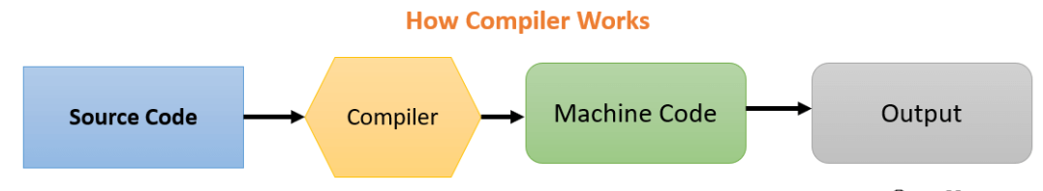
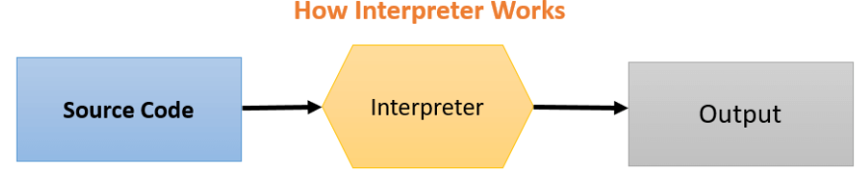
Compiler Vs Interpreter
Compiler
Interpreter
It reads the entire program and converts it into the object code
It shows errors of the entire program
It links different code files into a runnable program(know as exe)
Only error free programs are executed, once compiled, executed any no. of times
It reads only one line of a source code at a time and converts it into object code
In case of errors the same will be indicated instantly
No linking of files or machine code generation
Need to execute every time

Slide 36
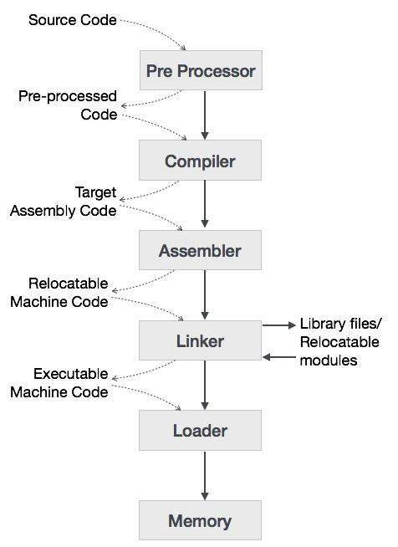
Language Processing System / Steps for Executing a Program:
Source program
modified source program
assembly language
relocatable machine code
machine code
Preprocessor
Compiler
Assembler
Linker / loader

Slide 37
Language Processing System / Steps for Executing a Program:
Preprocessor:
It takes the source code as input and generates modified source code
It removes the preprocessor statements and replaces with the definition of this
The statements which are processed before compilation i.e., code with no preprocessor statements
Two types of preprocessor directives
File inclusion (#include<stdio.h> i.e., header files Example: printf(), clrscr(), etc…)
Macros (#define PI 3.14 i.e., static values Example: PI , etc…)
Compiler:
It takes the modified source code as input and generates assembly language
It checks whether the given program follows the language syntax rules or not

Slide 38
Language Processing System / Steps for Executing a Program:
Assembler:
It takes the assembly language as input and generates relocatable machine code
Logical address: This is generated by the program
Physical address: It checks the free memory location in main memory
physical address = logical address + offset
Linker / Loader:
It takes the relocatable machine code as input and generates machine code
It links relocatable m/c code of various library functions to main program
Loader loads the executable files (.exe) into main memory for execution

Slide 39
The Science of Building a Compiler:
Building a compiler is a challenging task.
The main job of a compiler is to accept the source program of any size and convert it into suitable target program
Compiler study is focused mainly on study of how to design the correct mathematical model and choose correct algorithms, keeping in mind to balance the need for generality and efficiency
FSMs and REs are the prerequisites for describing the lexical units of programs (tokens) for describing the algorithms used by compiler to identify these tokens
Code optimization indicates the attempts made by a compiler to produce code which is more efficient than previous code
This code should be faster than any other code that performs the same task
The objectives to be fulfilled by the compiler optimization includes:
The meaning of the compiled program must be reserved
Optimization should improve program performance
Time required for compilation should be reasonable
The engineering effort required must be manageable

Slide 40
Phases of a compiler:
source code
stream of tokens
parse tree
correct parse tree
intermediate representation
optimized intermediate code
machine code
Lexical Analyzer / Scanner
Syntax Analyzer / Parser
Symbol Table
Error Handler
Symantec Analyzer
Intermediate Code Generator
Code Optimizer
Code Generator

Slide 41
Phases of a compiler (Cont…):
1. Lexical Analyzer / Scanner:
It reads the program character by character and converts it into meaningful sequences (lexeme → a sequence of character)
Each lexeme is represented in the form of tokens (identifier, keyword, constant, operator)
Each token is represented in the form of <token name, attribute value>
Tokens are defined by regular expressions which are understood by the lexical analyzer
Transition diagram is used to recognizing the tokens
2. Syntax Analyzer / Parser:
It checks the syntax for the corresponding code is correct or not
It takes the token one by one and uses Context Free Grammar to construct the parse tree
While constructing a parse tree, first identify the symbol with high priority as internal node and left & right child of internal node may be identifier or constant

Slide 42
Phases of a compiler (Cont…):
3. Semantic Analyzer:
It verifies the parse tree, whether it’s meaningful or not after that it produces a verified parse tree
It uses a software/ tool called type checker, will check the datatype of a variable and it performs if any need of type conversion
4. Intermediate Code Generator:
It generates the code that is very easy to convert this to machine code
Many ways to represent the intermediate code representation like three address, polish notation, etc…
Three address code
Assignment instruction must have at most one operator on the right hand side
Compiler must generate temporary variables for storing the result
Some instructions may contain fewer than 3 operands i.e., variables

Slide 43
Phases of a compiler (Cont…):
5. Code Optimizer:
It removes the unnecessary statements in the code so the length of the program is reduced as well as memory is saved and the CPU can execute the program in a fast manner
Optimisation can be categorized into two types
machine dependent
machine independent
6. Code Generator:
The main purpose of code generator is to write a code that the machine can understand
Inorder to perform the operations it uses some assembly level languages instructions like LD R,M, ST M,R, ADD R1,R2, ADD R1,R2,R3, etc…

Slide 44
Phases of a compiler (Cont…):
Symbol Table:
It is a data structure used and stores information about the tokens
It helps the compiler to function smoothly by finding the identifiers quickly
Error Handler:
The tasks of the Error Handler are to detect each error, report it to the user, and then make some recover strategy and implement them to handle error
Problems:
Consider the following fragment of C code: i=i*70+j+2 write the output of all phases of compiler for the above code
Show the output generated by each phase for the following expression x=(a+b)*(c+d)

Slide 45
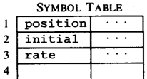




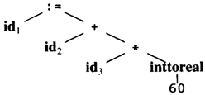
Example:
Code Generator
[Intermediate Code Generator]
Non-optimized Intermediate Code
Scanner [Lexical Analyzer]
Tokens
Code Optimizer
Parser [Syntax Analyzer]
Optimized Intermediate Code
Parse tree
Code Optimizer
Semantic Process [Semantic analyzer]
Target machine code
Abstract Syntax Tree w/ Attributes

Slide 46
Grouping of phases into passes:
Single Pass Compiler: All the phases are grouped into one part
Two / Multi Pass Compiler: All the phases are grouped into two parts
Basically there are two phases of compiler
Analysis part or front end of the compiler
Synthesis part or back end of the compiler
Analysis part creates an intermediate representation from the given source code and depends on source language & independent on target language
Synthesis part creates an equivalent target program from the intermediate representation and depends on target language & independent on source language
Compiler
Analysis
Synthesis

Slide 47
The Role of Lexical Analyzer:
Lexical Analyzer functions / Role of Lexical Analyzer
Separation of Lexical Analyzer from Syntax Analyzer
Tokens, Lexemes and Patterns token
Lexical Errors source program request for other token
1. Lexical Analyzer functions / Role of Lexical Analyzer
It produces a stream of tokens
It removes comments from the source program
It removes white space characters such as blank space, tab space and new line character
It counts line no’s of source program
It generates a symbol table which stores information about tokens
It provides error messages with corresponding line no’s and column no’s
Interaction between Lexical Analyzer and Syntax Analyzer
Lexical Analyzer
Syntax Analyzer
Symbol Table

Slide 48
The Role of Lexical Analyzer (Cont…):
2. Separation of Lexical Analyzer from Syntax Analyzer
To simplify the design of a compiler
To increase the efficiency of a compiler (In LA we uses Regular Expressions and SA means CFG)
To enhance the portability of a compiler (working on several platforms)
3. Token, Lexeme and Pattern
Tokens is a pair which is represented in the form of <tokenname, attributevalue>
Token name may be an identifier, keyword, operator or constant
Attribute value is a pointer which points to an entry of the symbol table for token information
Lexeme is a sequence of characters (Ex: E=m*c**2)
Patterns are mainly useful to define regular expression (Ex: identifier starts with (L/_)(L/d/_)*)
4. Lexical errors
These are generated during lexical analyzer process
Spelling errors (Ex: di in place of do)
Unmatched string (Ex: printf(“hai); in place of printf(“hai”); )
Appearance of illegal characters (Ex: printf(“hai”);@# )
Exceeding length of identifier (Ex: the length of variablein c is 32 printf(“hai”);@# )

Slide 49
The Role of Lexical Analyzer (Cont…):
The possible error recovery managers
Delete a single character from the remaining input (Ex: di delete the character i & replace with o)
Insert a missing character from the remaining input (Ex: prntf(“hai); insert i between r and n )
Replace one character by other character (Ex: fir replace i with o )
Transpose 2 adjacent characters (Ex: prnitf Transpose 2 adjacent characters ni by in)
Delete successor character from the remaining input until LA recognizes a well formed token. This process is called as panic mode error recovery approach (Ex: do @# Delete successor characters of @#)

Slide 50
Input Buffering:
LA scans the input from left to right one character at a time & produces tokens
Input buffering will read the program character by character
LA will take 25% to 30% of the compiler time
In order to read the tokens, LA uses 2 pointers
Lexeme Begin pointer (LBP)
Forward pointer (FP)
When the program is saved, it is stored in hard disk and even in compile time also but while execution the program must resides in main memory because execution done by the CPU
Ex: int main() { ….. }
Lexeme Begin pointer: points to the beginning character of the current lexeme
Forward pointer: placed at the beginning point of the lexeme. It reads the first character & moves ahead (right) in order to read next character. If it reads the blank space then it identifies that it is the end of lexeme and FP ignores the blank space and places the LBP & FP is placed at next location character i.e., m
i | n | t |  | m | a | i | n | ( | ) |  | { |  | }

Slide 51
Input Buffering (Cont…):
Here the problem is the corresponding problem is stored in hard disk. We can read only one character at a time from the hard disk. If the program is very large, it requires too many system calls.
We can overcome this problem with the help of buffering technique.
The use of buffering is block of characters are to be read into the buffer using only one system call.
Buffering can be implemented in two ways
1. One buffer scheme 2. Two buffer scheme
One buffer scheme
It uses only one buffer to read the input string
Ex: int i,j;
If the input string size is larger than the capacity of the buffer size then the buffer has to be overridden in order to store the remaining input string
Ex: size of buffer is 100 characters and size of the input string is 500 characters
We can overcome this problem with the help of two buffer scheme.
i | n | t |  | i | , | j | ;

Slide 52
Input Buffering (Cont…):
Two buffer scheme
It uses two buffers to read the input string and both the buffers are scanned alternatively
When the end of the current buffer is reached then the other buffer is to be filled
The LBP & FP are pointed to the first character of the first buffer
After the first buffer is completely filled with input string then we have to start filling of the second buffer
A special character eof or sentinel character is used to check whether first buffer is filled or not
eof is inserted as a last character of the corresponding buffer and it is not the part of the source program
If the second buffer also filled then the remaining input is over written on the first buffer
i | n | t |  | i | , | j | ; | eof
i | = | i | + | 1 | ; | eof

Slide 53
Input Buffering (Cont…):
Algorithm
switch(*forward++)
{
case ‘eof’:
if(forward is at end of first buffer)
{
forward = beginning of second buffer; refill second buffer; }
else if(forward is at end of second buffer)
{
forward = beginning of first buffer; refill first buffer; }
else
break;
cases for other characters
------------

Slide 54
Recognition of Tokens:
The tokens are specified with the help of regular expression and we can recognize those with transition diagram. Some of the examples are
Recognition of identifiers
Recognition of delimiters
Recognition of relational operators
Recognition of keywords (if, else, for….)
Recognition of numbers (int, float…)
Recognition of Identifiers
letter → a | b | … | z A | B | …. | Z
digit → 0 | 1 | 2 | 3 | 4 | 5 | 6 | 7 | 8 | 9
id → letter (letter | digit)*
letter, digit
letter
A
B

Slide 55
Recognition of Tokens (Cont…):
Recognition of Delimiters
Delimiter may be a blank space or tab space or new line character
ws → delimiter(delimiter)* (ws means word space)
Ex: first delimiter
second delimiter
Recognition of Relational Operators
>, >=, <, <=, ==, !=
> = (relop, GE)
Recognition of Keywords
if, else, for
i f
A
B
D
A
B
C
A
B
C

Slide 56
Recognition of Tokens (Cont…):
Recognition of numbers
Int no., floating point no. 123
digit → 0 | 1 | 2 | 3 | 4 | 5 | 6 | 7 | 8 | 9 123.456
digits → digit(digit)* 123.45 E 23
number → digits (.digits)?(E[+ -]?digits)? 123.45 E -23
digit digit digit
digit . digit E + / - digit other
E
other other digit
A
B
C
D
E
F
G
H
D
D

Slide 57
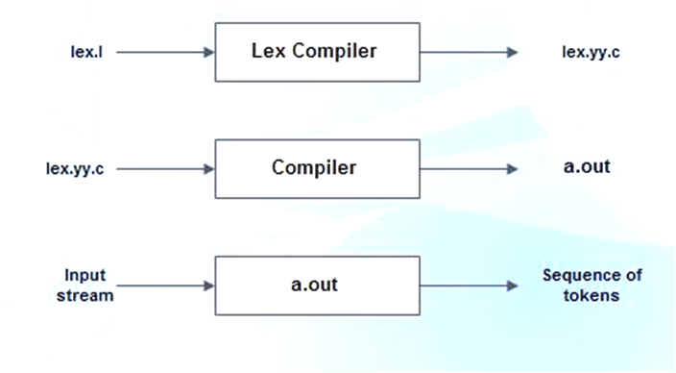
LEX Tool:
A language for specifying lexical analyzer or The lexical analyzer generator (LEX)
Lex is a tool or language which generates lexical analyzer & it’s used by YACC parser
It is written by Mike, Lesk & Eric and described in 1975
Lex is an acronym that stands for "lexical analyzer generator "
Example: lex, jflex, BOT, etc ...
Lex file execution → source program
Lex program structure:
1. declarations
2. %%
translation rules
%%
3. auxiliary functions

Slide 58
LEX Tool (Cont…):
Declarations:
Used to declare c variables & constants and must be write in between %{ %}
Example %{ int a,b; float count=0; %}
Used to define regular expression and no need to include %{ %}
Example digit [0-9] letter [a-zA-Z]
Translation rules:
Rules must write in between %% %%
Syntax: pattern {action} where pattern is a RE and action is a C language statements
Must separate the pattern and the corresponding action with at least one blank space
%%
pattern1 {action1}
pattern2 {action2}
pattern3 {action3}
%%
Must write each pattern in a new line
Auxiliary functions:
All the functions are defined in this section like main() { }

Slide 59
LEX Tool (Cont…):
Lex program to recognize identifiers, keywords, relational operators and numbers:
%{
/* lex program for recognize the tokens */
%}
letter [a-zA-Z]
digit [0-9]
id {letter}({letter / digit})*
numbers {digit}+ (. {digit}+)?(E [+ -])? {digit}+)?
%%
{id} {printf(“%s is an identifier”, yytext);}
if {printf(“%s is a keyword”, yytext);}
else {printf(“%s is a keyword”, yytext);}
“<“ {printf(“%s is less than operator”, yytext);}
{number} {printf(“%s is a number”, yytext);}
%%

Slide 60
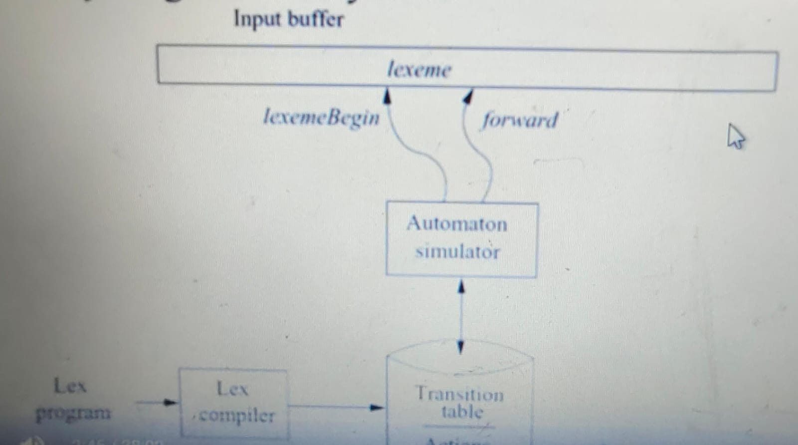
Design of a lexical-analyzer generator:
The structure of the generated analyzer
Pattern matching based on NFA’s
DFA’s for lexical analyzers
Implementing the Lookahead operator
We can apply the techniques learned earlier to see how a LEX is architected
like NFA with ε to DFA and RE → NFA → DFA
A LEX program is turned into a transition table
and actions which are used by finite automaton
simulator
The components are
Transition Table for the automata
Those functions that are passed directly through
LEX to the output Structure of Generated Analyzer

Slide 61
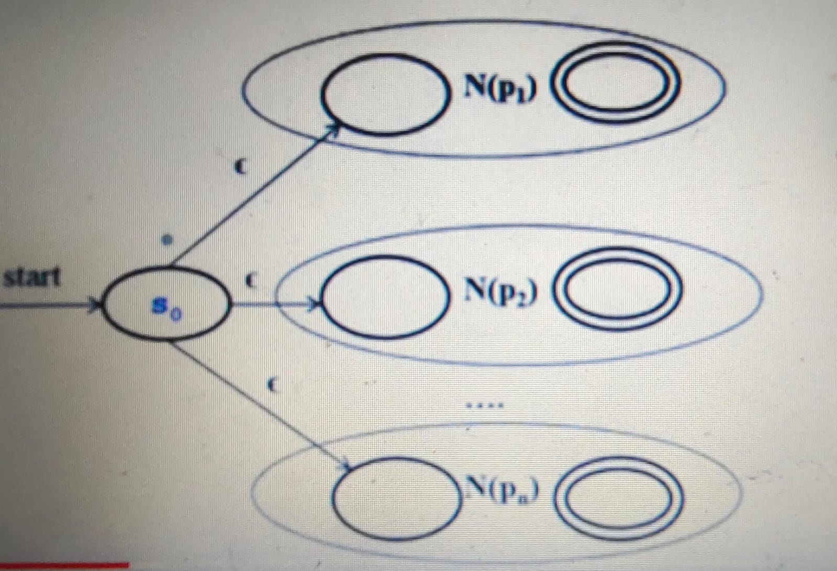
Design of a lexical-analyzer generator:
iii. The actions from the input program, which appear as fragments of code to be invoked at the appropriate time by the automaton simulator
To construct the automaton, we begin by taking each RE pattern in the LEX program and
converting it to a NFA
We need a single automaton that will recognize lexemes matching ay of the patterns in the
program, so we combine all the NFA’s into one by introducing a new start with ε -
transitions to each of the start states of the NFA’s Ni for pattern Pi. This construction.
Ex:
a {action A1 for pattern p1}
abb {action A2 for pattern p2}
a*b+ {action A3 for pattern p3}

Slide 62
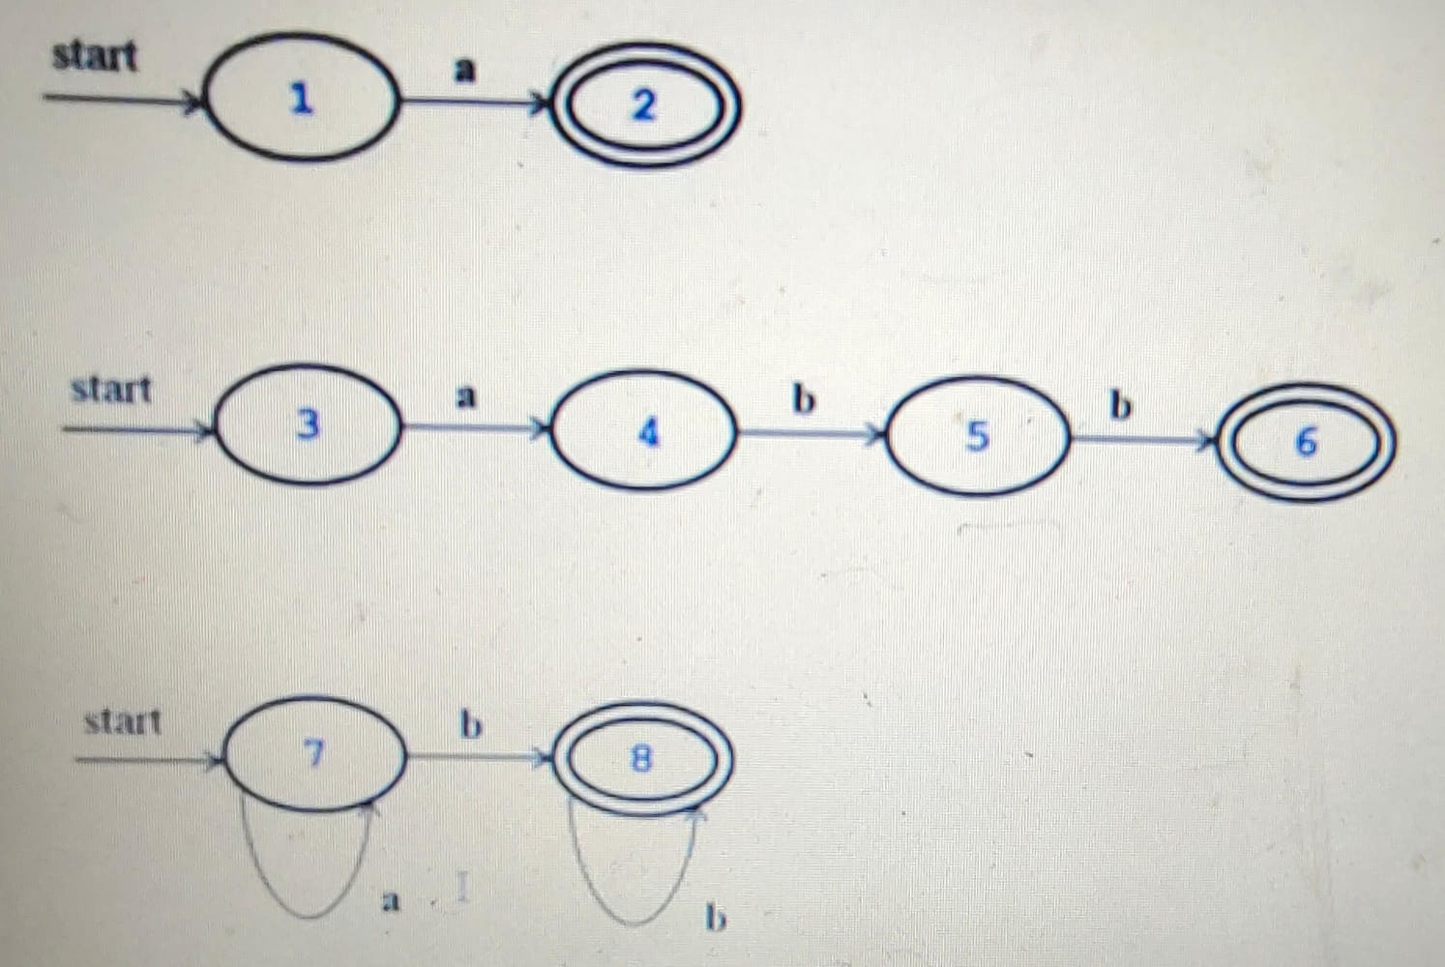
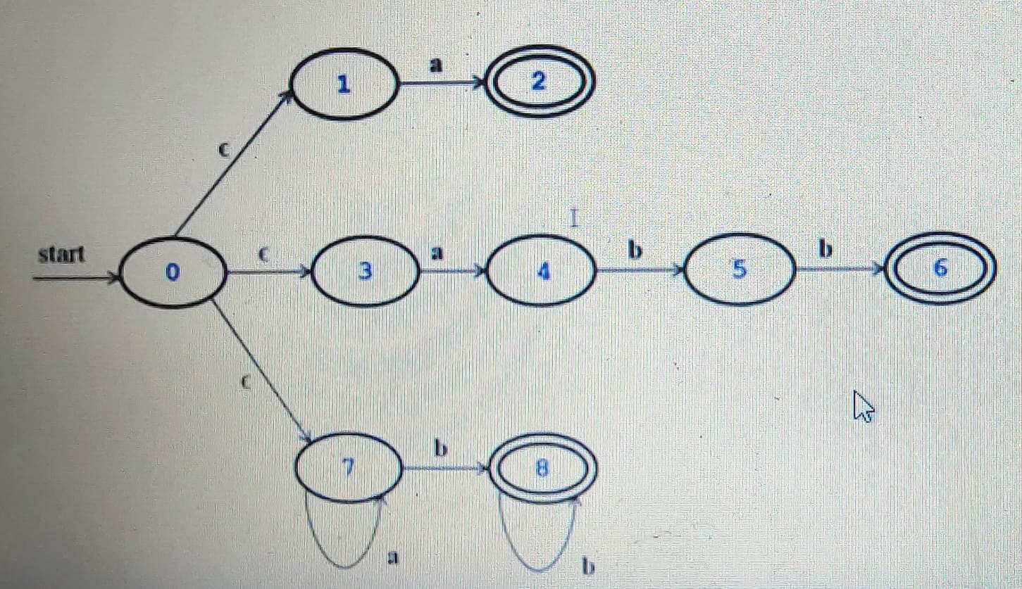
Design of a lexical-analyzer generator:
→
We need to combine all the NFA’s into single with common start state
Pattern matching based on NFA’s
If the LA simulates a NFA then it must read input beginning at the point on its input which we have referred to as leximbegin.
As it moves the pointer called forward ahead in the input, it calculates the set of states it is in at each point

Slide 63
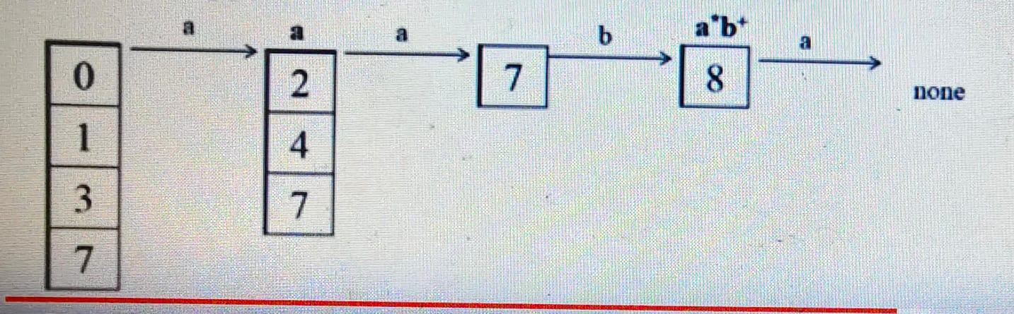
Design of a lexical-analyzer generator:
It continuous until the NFA simulation reaches a point on the input where there are no next states
At that point there is no longer prefix of the input would ever get the NFA to a accepting state
Thus we are ready to decide on the longest prefix that is a lexeme matching some pattern
We look backwards in the sequence of sets of states until we find a set that includes one or more accepting states
Move the FP to the end of the lexeme Ai associated with pattern pi
Ex: aaba is the input
Initially we can take the ε – closure of the initial state 0 → {0, 1, 3, 7} and proceed
On input a it reaches to {2, 4, 7} and on 2nd ‘a’ from state 7 to the same state {7} then on ‘b’ reaching from state 7 to state 8 then on ‘a’ there is no further state.
It means lexeme is not fund.

Slide 64
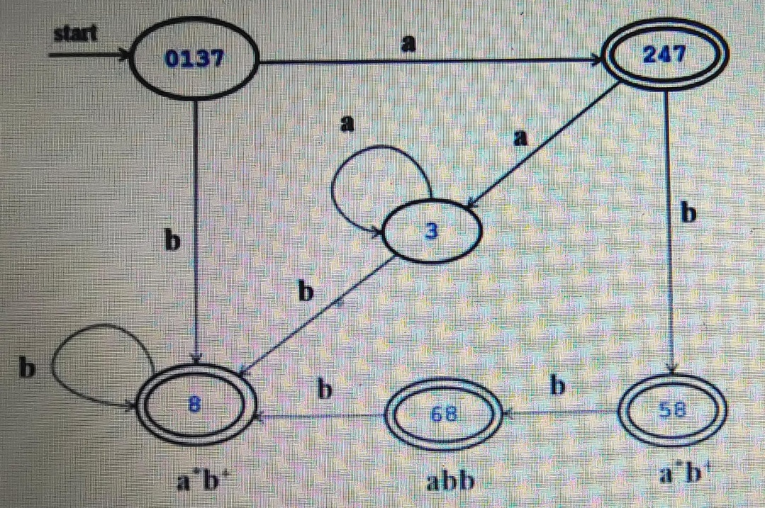
Design of a lexical-analyzer generator:
DFA’s for Lexical Analyzers
In this, we can convert NFA to equivalent DFA using subset construction method
Within each DFA state, if there are one or more accepting NFA states, determine the first pattern whose accepting state is represented and make that pattern the output of the DFA state

Slide 65
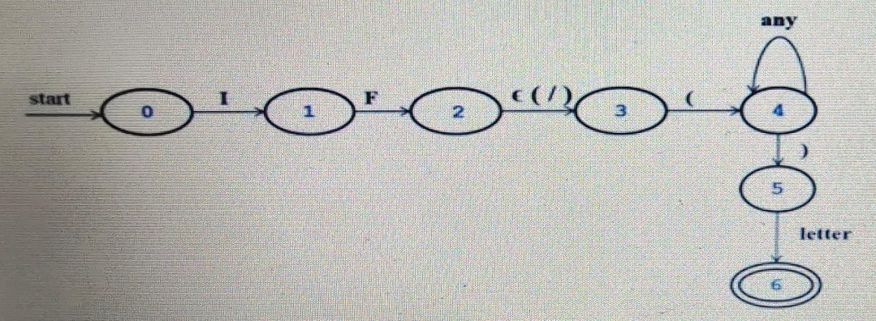
Design of a lexical-analyzer generator:
Implementing the Lookahead Operator
The LEX Lookahead Operator ( / ) in a Lex pattern r1 / r2 is sometimes necessary because the pattern r1 for a particular token may need to describe some trailing context r2 in order to correctly identify the actual lexeme.
When converting the pattern r1 / r2 to a NFA, we treat the / as if it were ε, so we do not actually look for a / on the input
Ex: an NFA for the pattern of IF with lookahead in FORTRAN
The ε transition from state 2 to state 3 represents the lookahead operator and state 6 indicates the presence of the keyword IF.
However we find the lexeme IF by scanning backwards to the last occurrence of state 2, whenever state 6 is entered.

Slide 66
Compiler Construction Tools:
For generating or constructing a compiler we uses several tools / softwares
Scanner generator → It accepts regular expression as input and produces lexical analyzer as output. Ex: LEX tool
Parser generator → It checks whether our token syntax is correct or not. If syntax is correct then it produces syntax analyzer / parse tree as output. Ex: YACC tool
Syntax Directed Translation Engine → It contains a collection of routines which are useful to traverse the parse tree and it produces intermediate code as the output. SA and ICG are implemented with the help of this
Data Flow Analysis Engine → It is useful during code optimization phase and in order
to produces optimized code. Code optimization can be done with the help of this
Code generator → It accepts optimized Intermediate Code as input and produces
machine code as output
Compiler Construction Toolkits → It contains integrated collection of routines in order
to construct the compiler

Slide 67
Bootstrapping:
It is process which is mainly useful to design a compiler
Any compiler is represented with the help of 3 languages.
Source Language SL TL
Target Language
Implementation Language (The language in which compiler is written) IL
We can represent this compilation process with the help of T-diagrams
It is a process in which a simple language is useful in order to translate a complicated program but this complicated program produces even more complicated program and so on
Cross Compiler: A compiler which runs on one machine but produces object code for another machine.
Paskal C Pa C
C C++
Compiler
Compiler
Compiler

